Slide 1
We Can Read and Analyze any Data with Python
By: Iman Khani Jazani
AI and Data Specialist, Business Developer | AiHum
Adjunct Professor | Sharif University of Technology
Senior Data Scientist, Community builder | Adin

Slide 2
Last Lecture
Short Presentations
Random number generation
Sampling from distribution
Introduction to linear algebra with Numpy
Introduction to SciPy
Application of Programming in the Digital Age!

Slide 3
Today
Review
Read data from different sources and manipulate them!
Read files from HDD
Read sheet-based (tabular) files with Pandas
Read images, audios, …
Read website with Request (for the next session)
Algorithm and time complexity: Merge Sort
Application of Programming in the Digital Age!

Slide 4
Together
Send your feedback about the class whenever you want!

Slide 5

Contact me
Gmail: ImanKhaniJazani@gmail.com
LinkedIn: https://www.linkedin.com/in/ImanKhaniJazani/
Telegram: @IKJ1992

Slide 6
Review the Last Lecture

Slide 7
Pseudo-Random number generator algorithm
Accept some initial input number, that is a seed or key.
Apply that seed in a sequence of mathematical operations to generate the result. That result is the random number.
Use that resulting random number as the seed for the next iteration.
Repeat the process to emulate randomness.

Slide 8
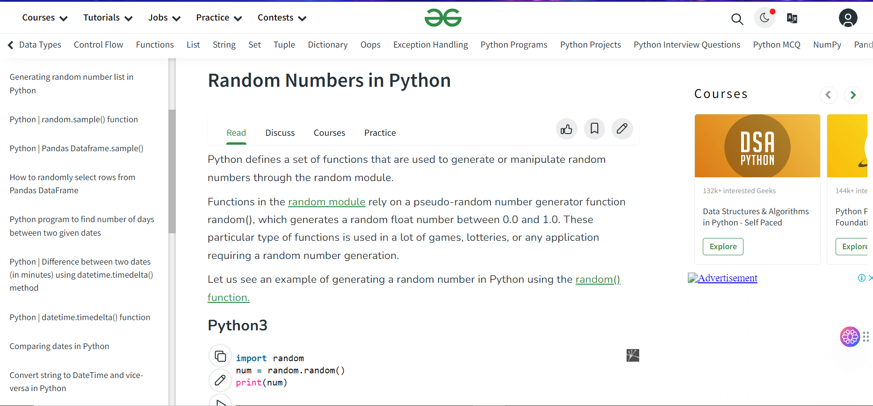
Let’s go to Python!

Slide 9
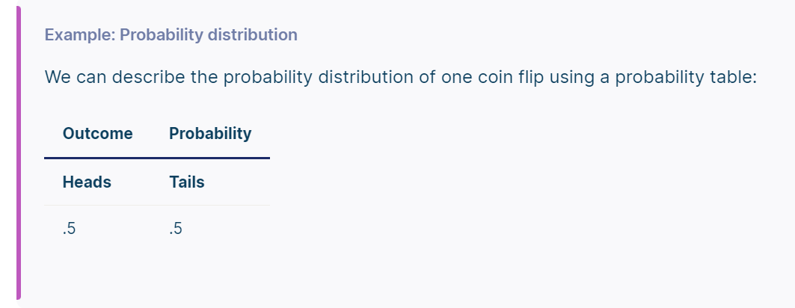
What is distribution?
A probability distribution is a mathematical function that describes the probability of different possible values of a variable. Probability distributions are often depicted using graphs or probability tables.
Notes:
https://www.scribbr.com/statistics/probability-distributions/

Slide 10
What is sampling?
A sample is a subset of individuals from a larger population. Sampling means selecting the group that you will actually collect data from in your research. For example, if you are researching the opinions of students in your university, you could survey a sample of 100 students.
Notes:
https://www.scribbr.com/frequently-asked-questions/what-is-sampling/

Slide 11
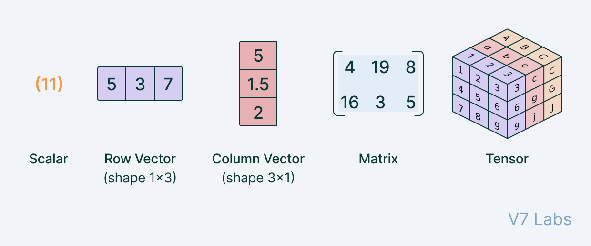
What is vector? matrix? tensor?

Slide 12
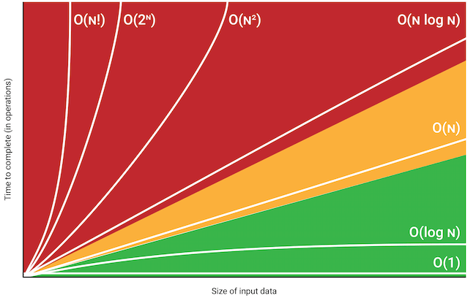
Let’s go to implement in python and time complexity!
scalar * vector
vector + vector
matrix + matrix
matrix * matrix

Slide 13
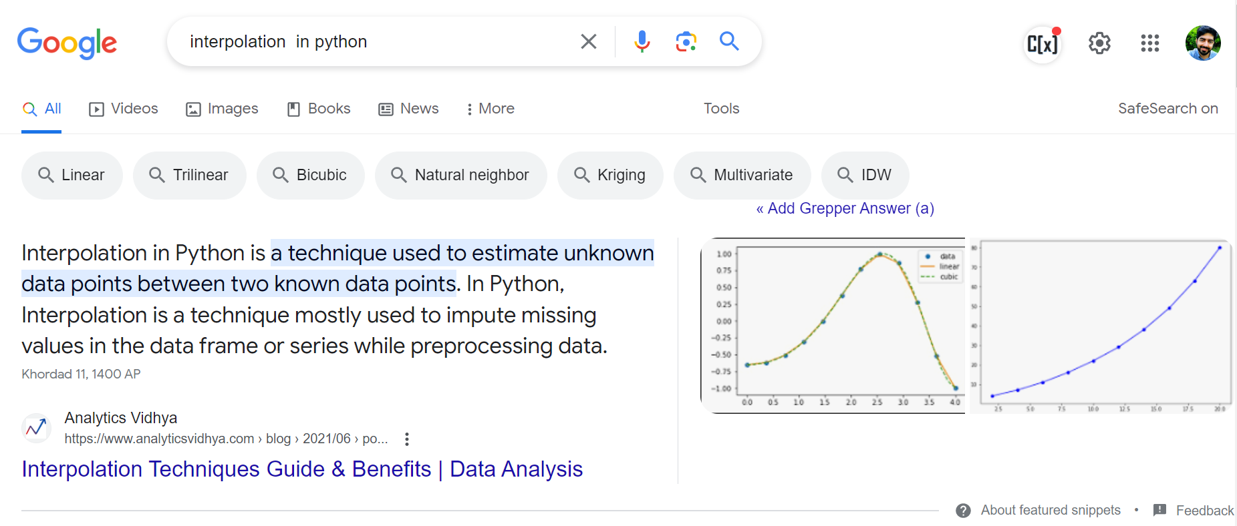
What is interpolation?

Slide 14
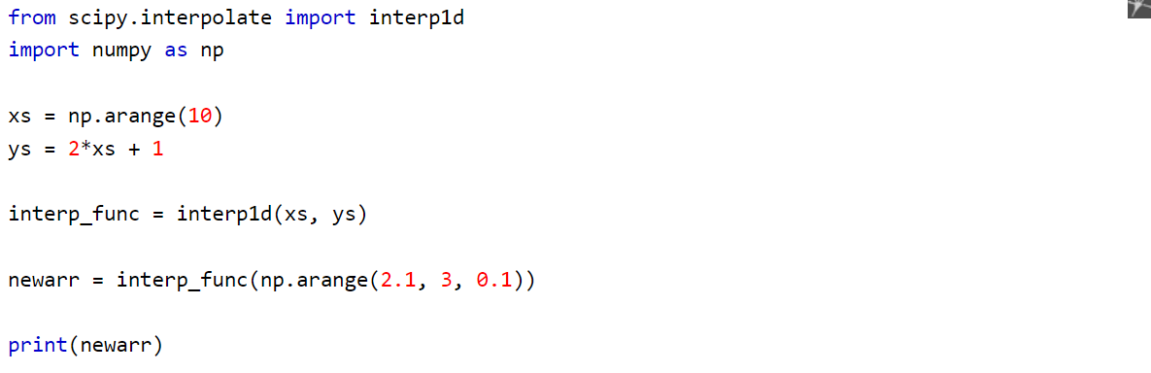
Interpolation with SciPy
0 1 2 3 4 5 6 7 8 9 -> 1 3 5 7 …
Notes:
https://www.w3schools.com/python/scipy/scipy_interpolation.php

Slide 15
Read data from different sources

Slide 16
Different source of data
Social media
News website
Podcasts
YouTube (UGCs)
Your local machine
Databases
…

Slide 17
We are different application! SO?
We may need:
Data integration
Automation
Data analysis
Data story telling
Scalability
…

Slide 18
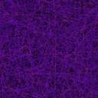
Python is very flexible with different data sources!

Slide 19

Read files from HDD
Chapter 23,
from Prof. Nowzari’s slide:
https://github.com/SharifPythonSpace/Course1401/tree/main/DrNowzariSlides

Slide 20
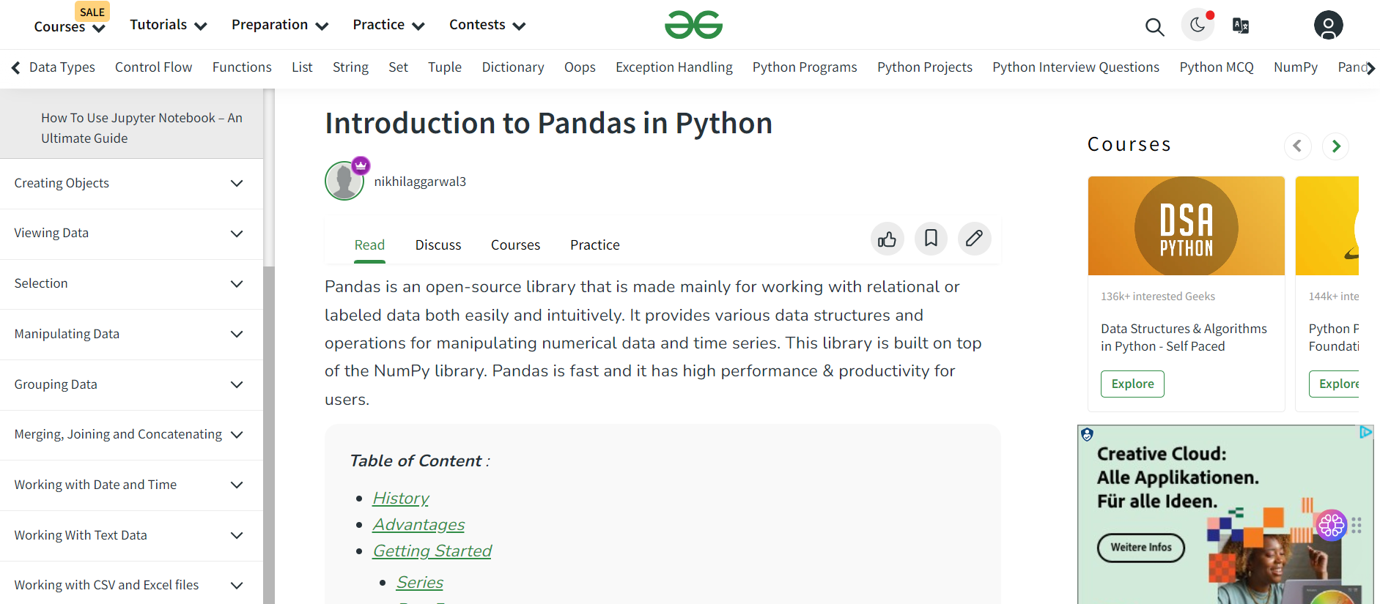
Read sheet-based (tabular) files with Pandas, let’s go!
Notes:
https://www.geeksforgeeks.org/introduction-to-pandas-in-python/ https://www.geeksforgeeks.org/how-to-get-cell-value-from-pandas-dataframe/

Slide 21
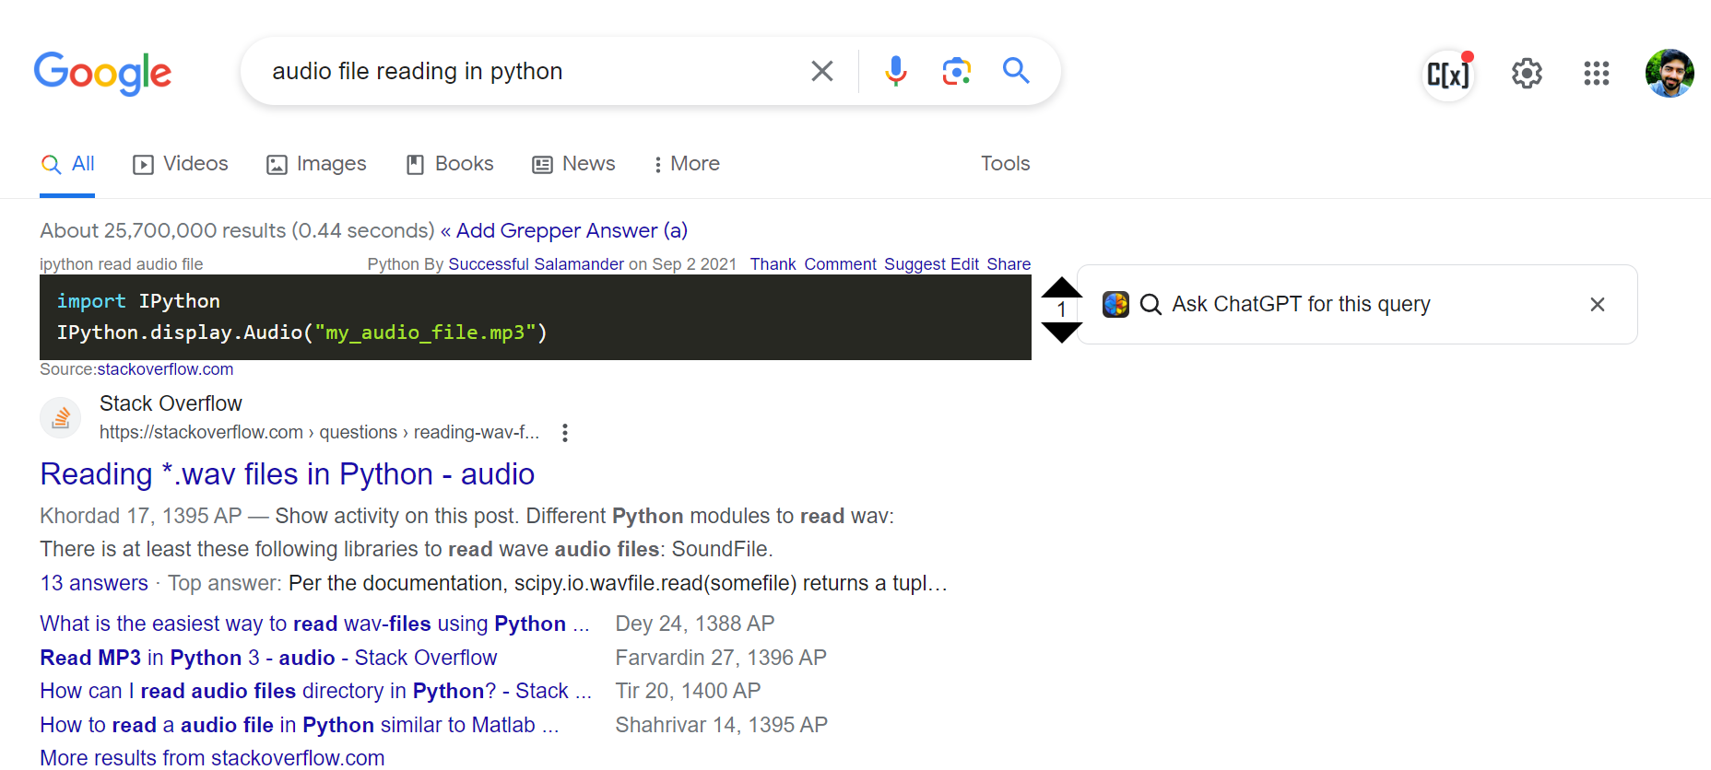
Search in google for audio, image, and etc. manipulation libraries

Slide 22
Application of Programming in the Digital Age!

Slide 23
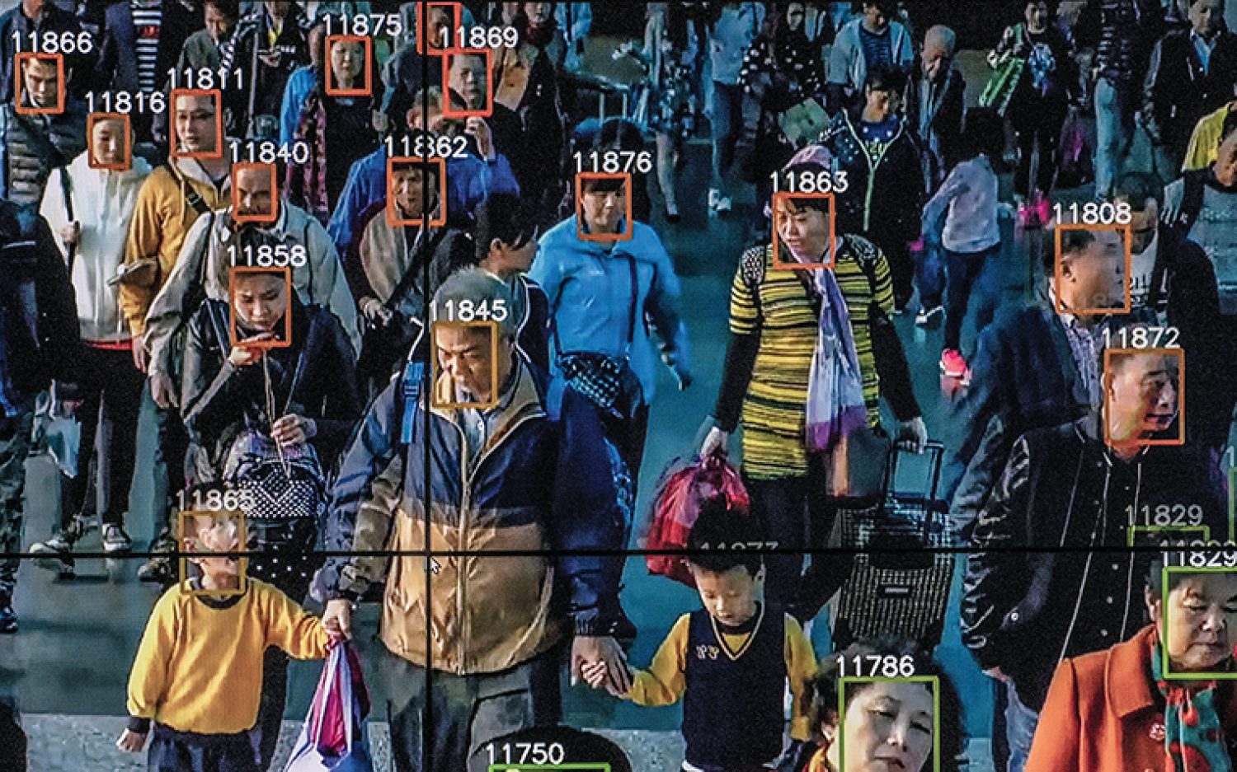
Is it ethical!?
Monitoring

Slide 24
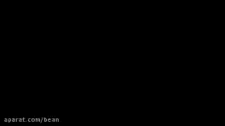
Cozmo robot
Notes:
https://www.aparat.com/v/bXHvR

Slide 25
Lecture Resources
https://www.w3schools.com/python/pandas/default.asp
https://pandas.pydata.org/docs/user_guide/10min.html
https://www.w3schools.com/python/python_file_handling.asp
https://realpython.com/working-with-files-in-python/

